Slide 1

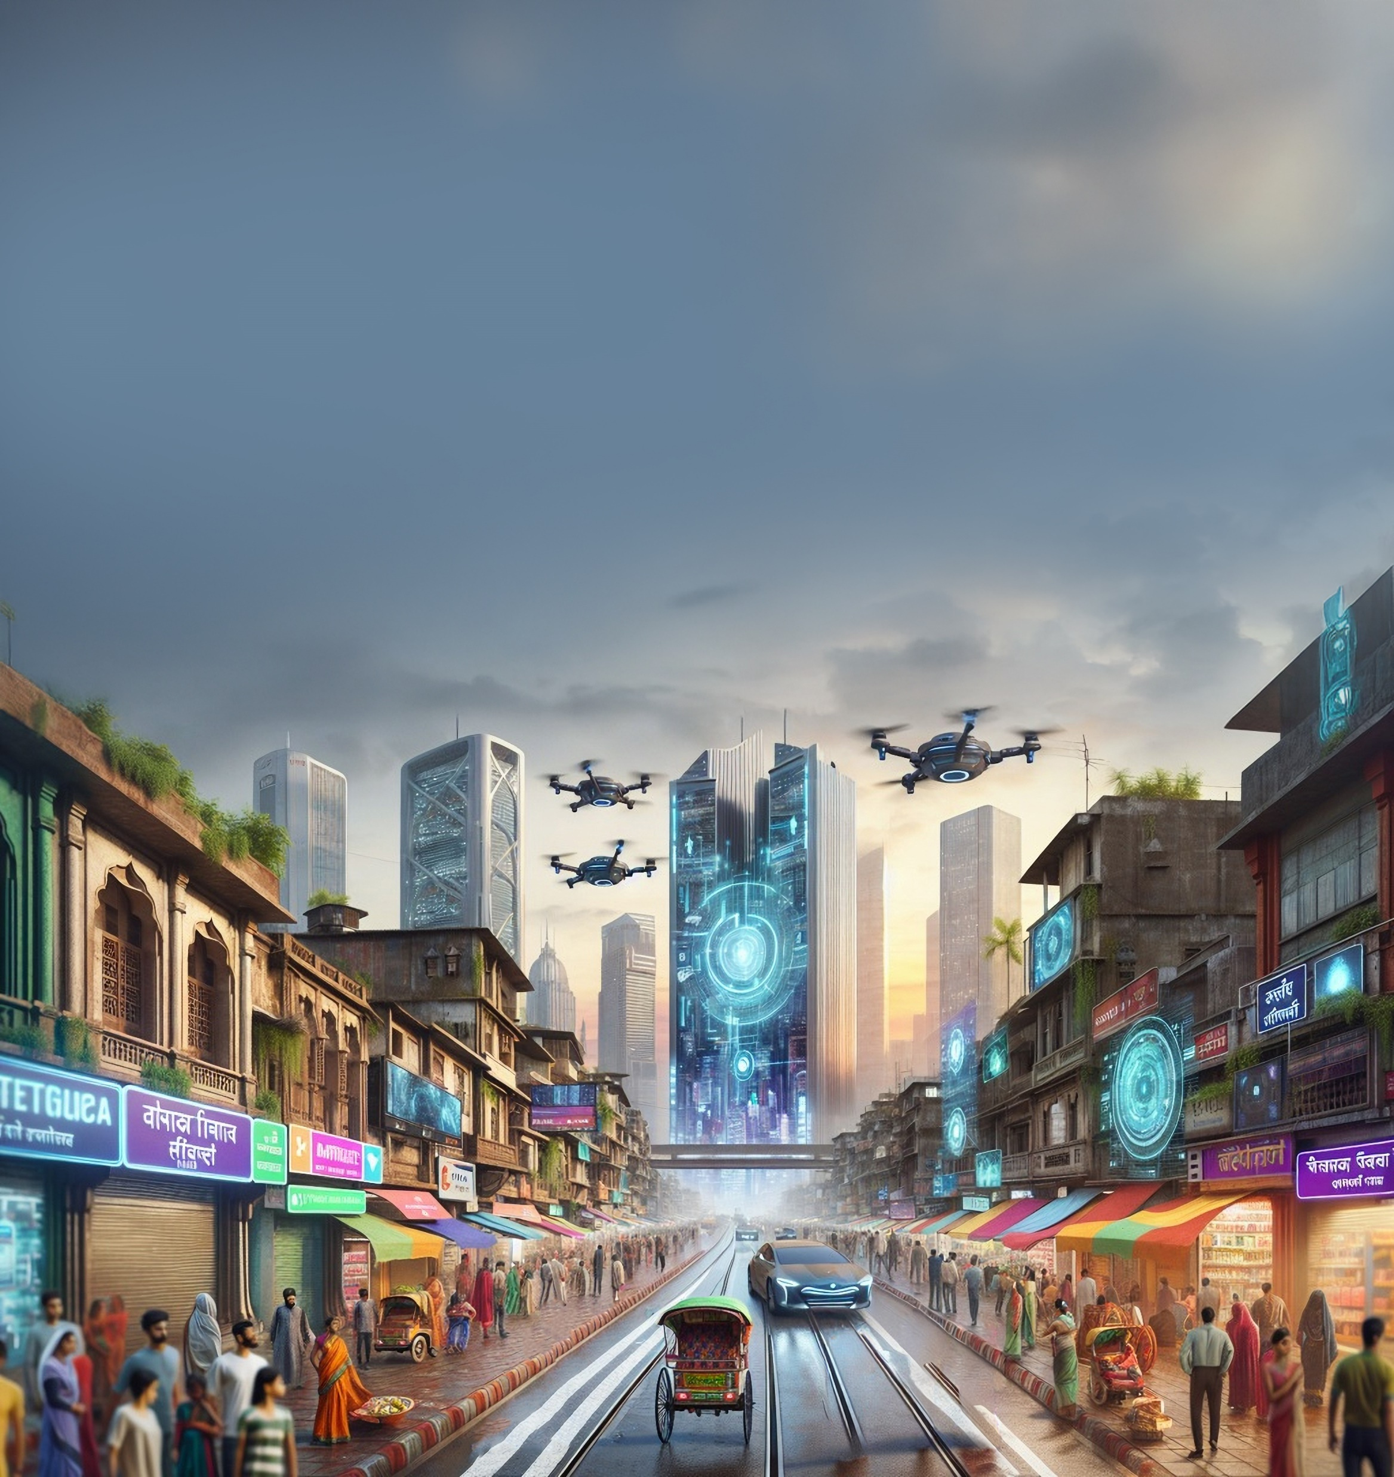




EY Techathon 6.0 Detailed Submission
Date of submission:
Notes:
1

Slide 2


Congratulations on making to the next round. As we move towards the next stage, we would like you to note a few key points
We are inviting a detailed solution submission for the next round. The ppt document that you submit should cover the below :
Team Details (refer slide 3 – pictures should be high resolution; Size: 1200X1800 | 2MB; Front facing camera; Attire: Formal | Presentable | No accessories like sunglasses etc | Plain background)
Executive Summary (refer slide 4)
Problem statement and Solution proposed (refer slide 5)
Approach and methodology (refer slide 6)
Details to be submitted separately (refer slide 7)
Working prototype/output (refer slide 8 - this is key to your presentation and you/ your team will be expected to screen share and demonstrate the same if you make it to semi-finale round) (kindly record and share the video file of the prototype demonstration (as a backup file))
Expected output should be in form of demonstratable technology solution (This is mandatory)
Evaluation parameters
Scope of the problem covered in the solution
Solution design and use of technology
Uniqueness of Solution and Innovation
End-user benefit and impact
Please upload your submissions on the Unstop website (PPT in .pptx, Video files in .mp4 formats only)
Submission link will be live on XX. Last date for submissions is XX.
Page ‹1›
Notes:
2

Slide 3

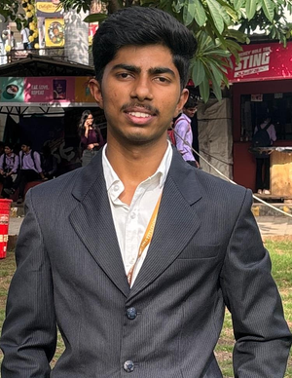


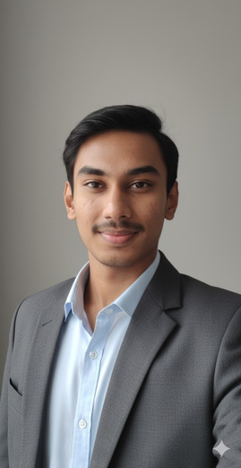
Tell us about yourself | Highlight a technical skill or skills each member brings to the team
Team Name: FiNova
Problem Statement: FiNova Banking Financial Services and Insurance (BFSI)Tata Capital
Team Member 1 pic
Team Member 2 pic
Team Member 3 pic
Team Member 4 pic
Team Member 1 Name : Utkarsh Neel.
College name :GH Raisoni College Of Engineering And Management.
Contact Detail (phone number): 9527230954
Role in Solution Development : •Slide animations and visual •Graphic assets for demo (icons, flows, visuals)
Team Member 2 Name :
Jay Deepak Jadhav
College name :GH Raisoni College Of Engineering And Management.
Contact Detail (phone number): 7558317165
Role in Solution Development : •Project Manager
•AI Agent designer Research & Documentation
Team Member 3 Name :
Aditya Suryawanshi
College name :GH Raisoni College Of Engineering And Management.
Contact Detail (phone number) 8793269019
Role in Solution Development :
•Frontend Developer
•Backend architecture
& seamless user experience
Team Member 4 Name : Nikhilesh Khairnair
College name :GH Raisoni College Of Engineering And Management.
Contact Detail (phone number) 9607204890
Role in Solution Development :
•Dataset & Model Manager
•ML underwriting model
•Testing with edge-cases
Page ‹2›
Notes:
3

Slide 4
Executive Summary (minimum 200 words)
Today, getting a personal loan still feels slow and complicated for most customers. They fill long forms, upload documents multiple times, and then wait hours or even days for someone to review their details. For NBFCs and lenders, this means high operational effort, low conversion rates, and an overall loan process that simply doesn’t match the speed customers expect in a digital world.
Our solution, FinBot, aims to change this experience completely. FinBot is an AI-powered conversational assistant that can guide a user through the entire loan journey — from the first question to the final sanction letter — all within a simple chat interface. It uses an Agentic AI system where a central Master Agent coordinates multiple Worker Agents that handle verification, underwriting, and document generation. By using mock CRM and credit data along with clear underwriting rules, FinBot provides instant, transparent decisions.
With this approach, approvals that once took days can now happen in just a few minutes. This not only creates a faster and more satisfying experience for customers but also reduces manual workload for lenders by more than half. Our goal is to make lending more efficient, scalable, and trustworthy, while giving users the instant clarity they deserve.
FinBot moves digital lending from slow and manual — to smart, conversational, and truly instant.
Page ‹3›
Notes:
4

Slide 5
Problem statement - Your understanding
Define the exact problem that you intend to solve and your understanding of the same. Share the below details:
Target Industry: Banking, Financial Services, and Insurance (BFSI). Focus on NBFCs and retail lenders who handle high volumes of small-ticket personal loans.
Industry Type: B2C (Business to Consumer)
User Group: Loan Applicants (Customers) seeking instant personal loans. Loan Officers / Operations Teams at NBFCs managing loan approvals and document verification.
User Department: Sales, Verification, Underwriting, and Compliance departments within NBFCs and banks — involved in the loan lifecycle.
Solution Scenario: A customer chats with FinBot on the NBFC website to verify KYC, check eligibility, and receive instant loan approval, conditions, or rejection—all within a single session.
Proposed Data Flow: User chat inputs are validated via mock APIs, processed by agent services, logged in PostgreSQL with documents stored in S3, and the final loan decision or sanction letter is returned to the user.
Nature of Output: A web-based chat interface accessible on desktop/mobile, with future support for WhatsApp and voice assistants.
Page ‹4›
Notes:
5

Slide 6
Explain, in brief, how you intend to solve the problem at hand. Preferably include the following (Methodology/approach):
Please state the assumptions, constraints and solution decision points (Reason behind choosing a technology)
Please elaborate on the solution value proposition to the target user group. How will your solution cover the problem areas?
Response:
We assume access to mock CRM and credit data.
We chose OpenAI for stable conversation quality and LangGraph/CrewAI for multi-agent orchestration.
FastAPI + PostgreSQL provide simplicity and speed.
Constraints include synthetic data and no real bank integration in hackathon stage.
Response:
FinBot completes the loan journey in a single chat, giving customers speed and clarity while eliminating manual delays. For lenders,
it reduces workload, improves conversions, and standardizes decisions using conversational AI, underwriting rules, and mock APIs.
What are the impact metrics that you propose to use to analyse the effect of the solution?
How robust / secure / easily scalable and extensible is the solution?
Response:
Effectiveness will be measured through <5-min approval time, 2–3× conversion uplift, ~60% reduction in manual checks, improved user satisfaction, and efficient system throughput.
Response:
Horizontally scalable microservices with secure HTTPS, JWT, and PII redaction; modular stateless agents enable easy extension to new loan types, languages, and channels like WhatsApp or voice bots.
Page ‹5›
Notes:
6

Slide 7
Explain, in brief, how you intend to solve the problem at hand. Preferably include the following (Methodology/approach):
What are the technologies (languages, platforms, APIs, hardware, sponsored tools, technologies stacks, framework etc.) involved?
What are the solution components that you would like to build and demonstrate; if you progress through next round.
How easily can your solution be implemented and how effective will it be?
Response:
Frontend: Next.js, React, Tailwind CSS
Backend: FastAPI (Python), Node.js (microservices)
AI & Multi-Agent System: OpenAI API, LangGraph/CrewAI
Database & Cache: PostgreSQL, Redis
Storage: S3-compatible object store
DevOps:GitHub Actions, Vercel, Railway/Render
Response:
If selected for further rounds, we will demonstrate:
FinBot chat interface (web)
Master Agent + Worker Agent orchestration
Automated verification & underwriting flow
Live generation of sanction letter (PDF)
Mock CRM and credit bureau integration
Transparent decision explanation
Dashboard for audit logs & flagged cases
Response:
FinBot is designed to be modular and lightweight, making it easy to implement as a standalone web application or integrate into existing lender workflows. Its conversational nature reduces onboarding friction for users. Even with mock services, the system demonstrates real-world effectiveness by automating underwriting, verification, and sanction generation.
Page ‹5›
Notes:
6

Slide 8

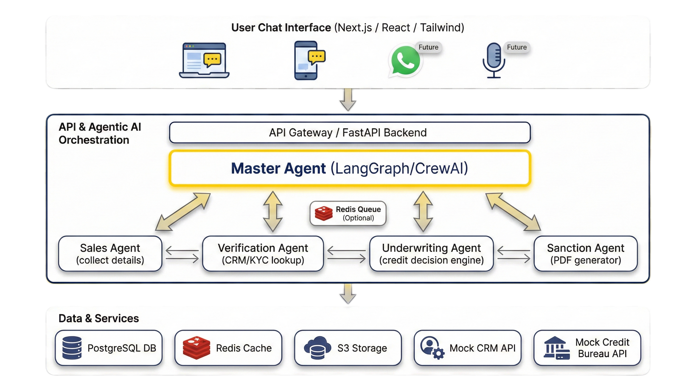
ARCHITECHTURE
Page ‹6›
Notes:
7

Slide 9
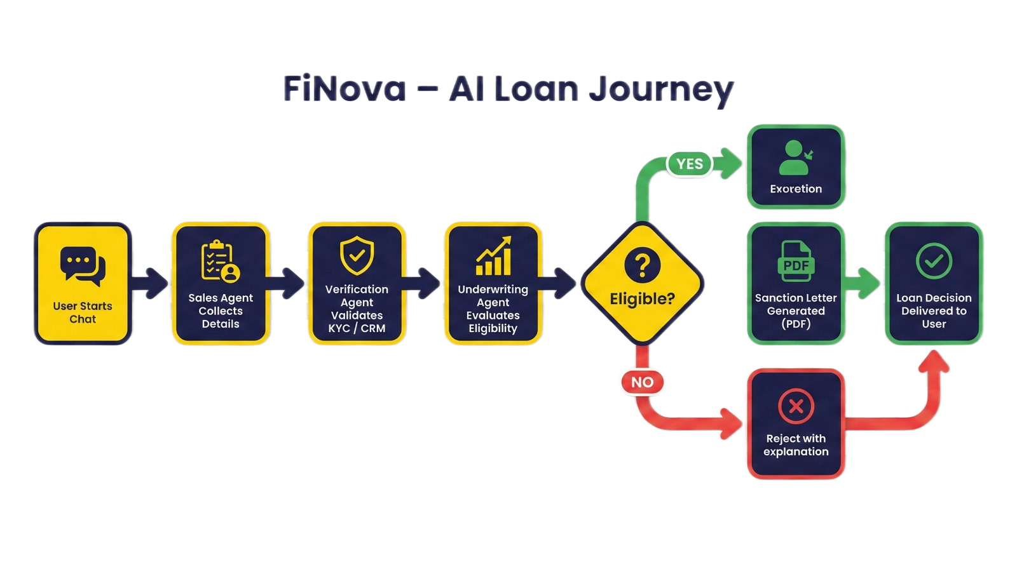
FLOWCHART
FiNova : AI-Loan Journey
FiNova starts by chatting with the user and collecting required loan details.
AI agents then verify KYC/CRM data and assess eligibility through automated underwriting. If eligible, the loan is sanctioned and a PDF letter is generated; if not, a clear rejection reason is shared.
The final loan decision is delivered instantly, reducing manual effort and turnaround time.
Page ‹6›
Notes:
7

Slide 10
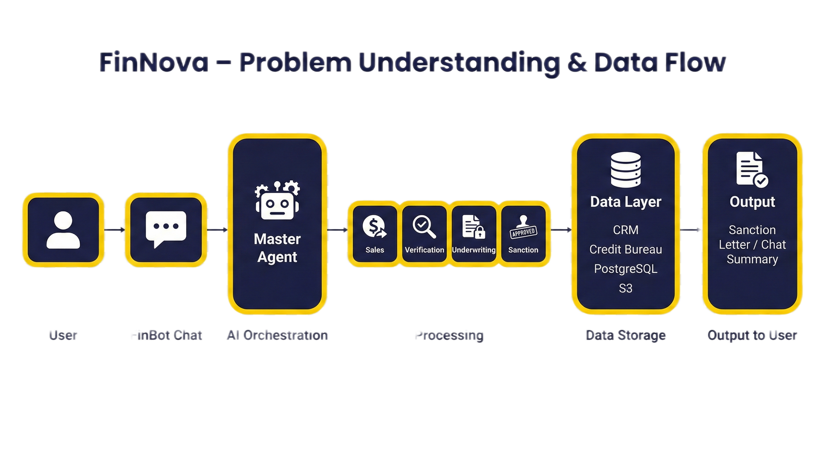
DATAFLOW DIAGRAM
FiNova - Problem Understanding & Data Flow
FiNova begins with a user conversation where loan requirements are captured through chat.
A Master AI Agent orchestrates specialized agents for sales, verification, underwriting, and sanctioning.
These agents interact securely with the data layer, including CRM systems, credit bureaus, PostgreSQL, and S3 storage.
User
FiNova Chat
AI Orchestration
Processing
Data Storage
Output to User
Page ‹6›
Finally, FiNova delivers a clear output to the user as a sanction letter or a concise chat-based decision summary.
Notes:
7

Slide 11
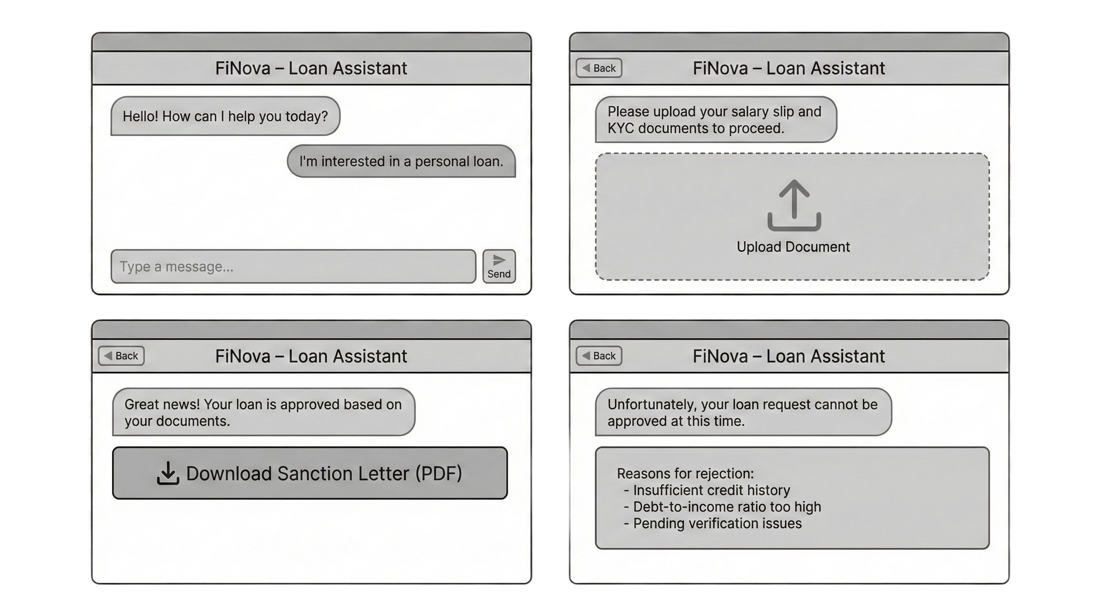
FiNova
Page ‹6›
Notes:
7

Slide 12




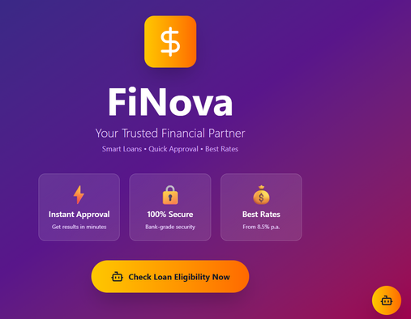
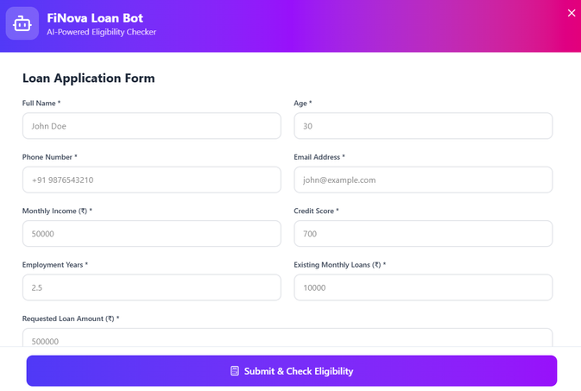
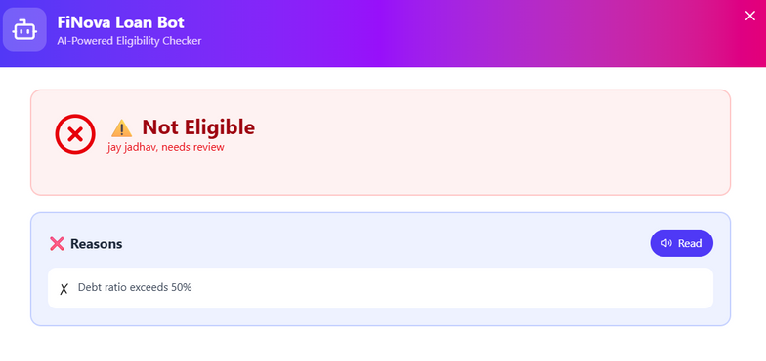
Youtube:-
https://youtu.be/z2pMCMNqB8E
GitHub:-
https://github.com/jdjadhav/FiNova-FinancialBot.git
Page ‹#›
Notes:
8

